Slide 1

AI-Driven Adaptive Physical Testing for Embedded Systems
UN Sustainable Development Goal - 9
Industry, Innovation & Infrastructure
Team 29 | Chip Tech | EL Phase I

Slide 2
Introduction
Background
Embedded systems can experience failures under specific combinations of voltage levels, workloads, peripheral states, and event timings. Exhaustively testing every possible combination is impractical, making efficient and reliable testing essential.
Proposed Solution
The Adaptive Hardware Fuzzing Testbench (AHFT) proposes a safety-constrained testing framework that learns from previous hardware experiments to select subsequent tests intelligently. It aims to discover, reproduce, and minimize system-level failures while operating within predefined safety limits.

Slide 3

Introduction
Problem based learning
This project follows a problem-based learning approach by addressing the real-world challenge of inefficient embedded-system testing, requiring us to investigate existing methods, identify their limitations, and develop and evaluate an adaptive, safety-constrained solution through experimentation.
SDG Alignment
SDG 9 — Industry, Innovation and Infrastructure
Target 9.5: Supports technological innovation and research through adaptive hardware-testing methods.
Sustainability principles: Reliability, resilience, and efficient use of testing resources.

Slide 4
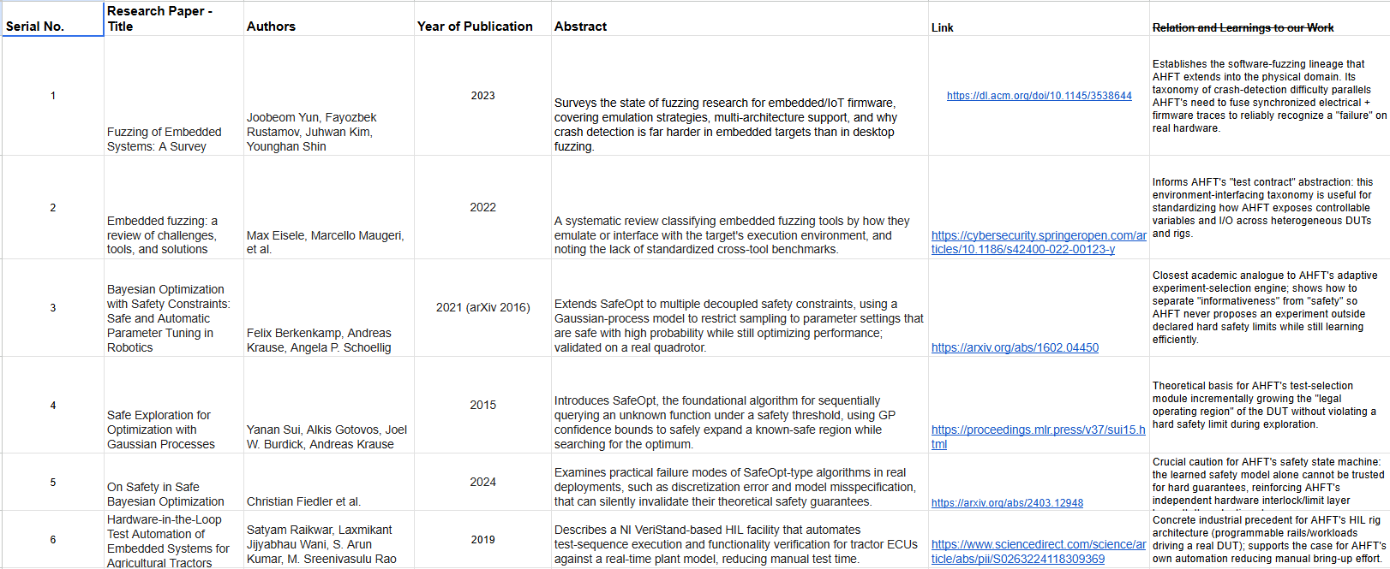
Literature Review
https://docs.google.com/spreadsheets/d/1XoIdEJ94GM5O8eeq7zOlil-07-r5dy2Zr2UhShgsFCg/edit?usp=sharing

Slide 5
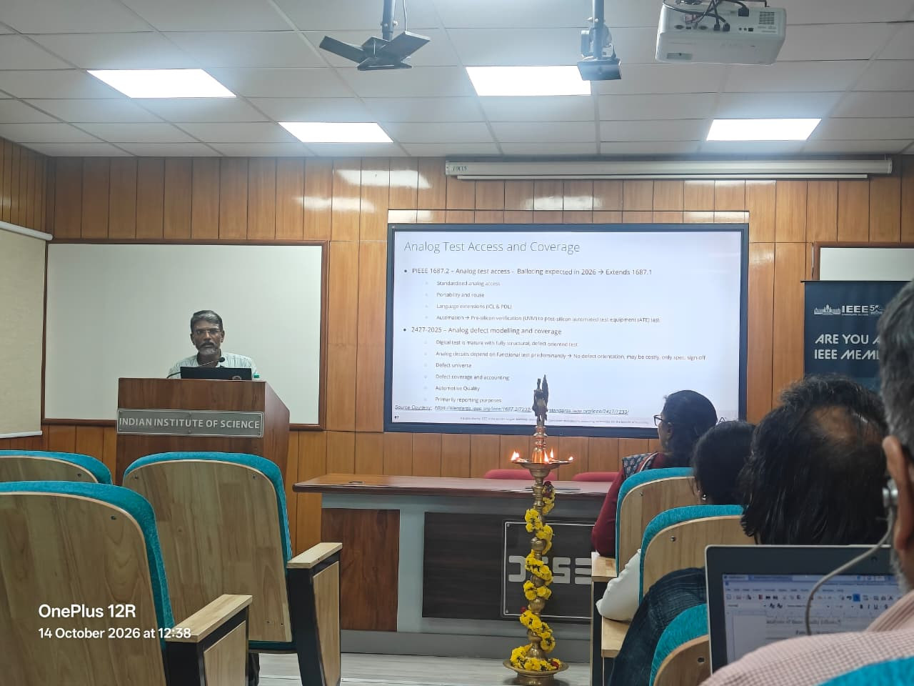
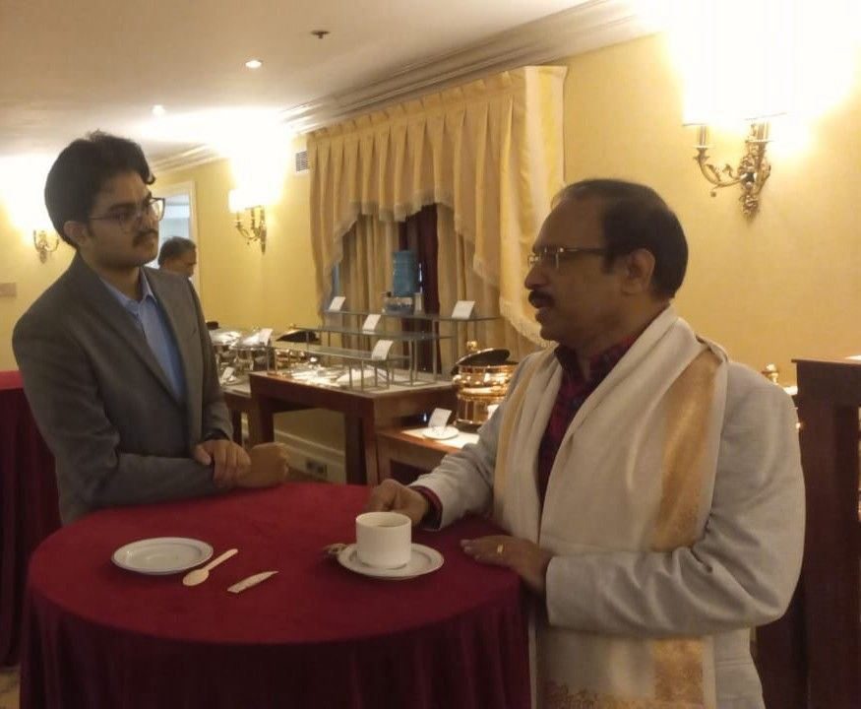
Industry Interaction
https://docs.google.com/spreadsheets/d/1XoIdEJ94GM5O8eeq7zOlil-07-r5dy2Zr2UhShgsFCg/edit?usp=sharing
14th October, 2026 - IEEE World Standards Day @IISc, Bengaluru
-> Could Interact with Mr. Lakshmanan Balasubramanian, Texas Instruments
Maxon India Event @Windsor manor
Dr.Ashokan T, Mechanical Prof IITM

Slide 6
Problem Definition
Project Objective
To develop and evaluate a safety-constrained adaptive testing engine that uses/learns from the previous experimental results to select informative hardware tests, discover failures using fewer experiments, and identify the minimal conditions required to trigger them.
Research Question: Can adaptive, feedback-driven testing discover and minimize embedded-system failures more efficiently than conventional testing approaches without executing tests outside the permitted safety envelope?

Slide 7
Objectives
Develop an adaptive testbench to find embedded-system failures within defined safety limits and a fixed experiment budget.
Specific Objectives:
Build a testbench setup with controlled voltages and workloads.
Use TPE (Tree-structured Parzen Estimator) to select tests from previous results.
Detect, reproduce and minimize failures using measured behaviour.
Compare failure discovery against Random and Grid Search.
Expected Contribution: A reproducible testbench and evidence on whether adaptive search finds failures in fewer physical experiments.
Referencing to IEEE 1804 2017, continuing to add on/ optimize to analog fuzzing [https://standards.ieee.org/ieee/1804/4604/]

Slide 8
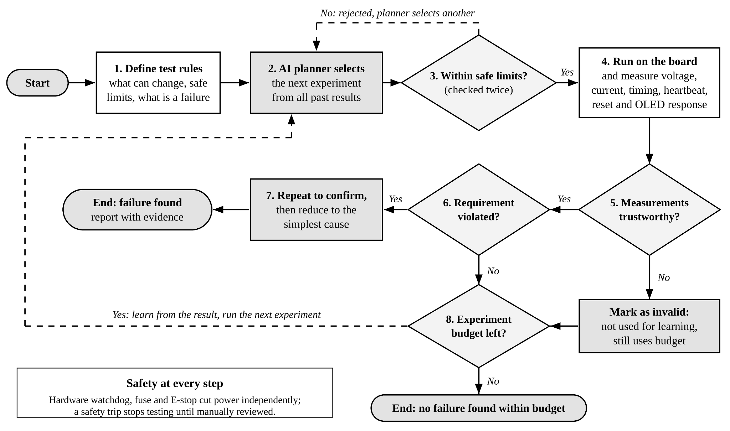
Methodology - Proposed methodology

Slide 9
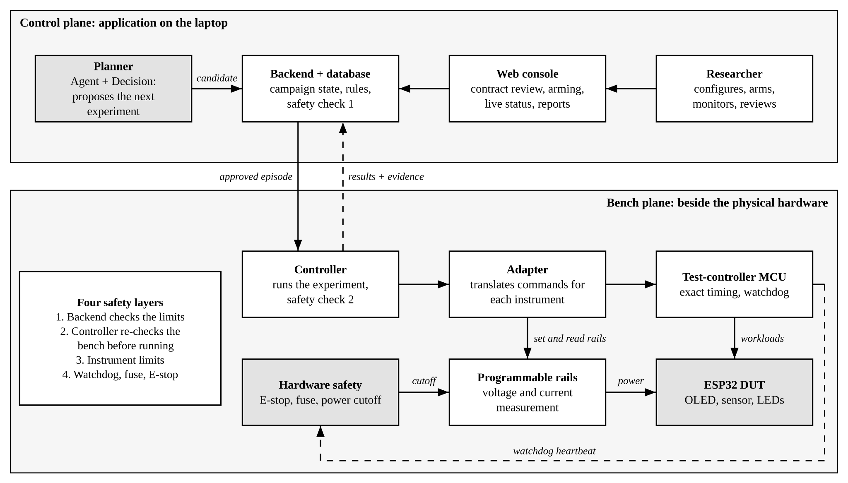
Methodology - System Architecture

Slide 10
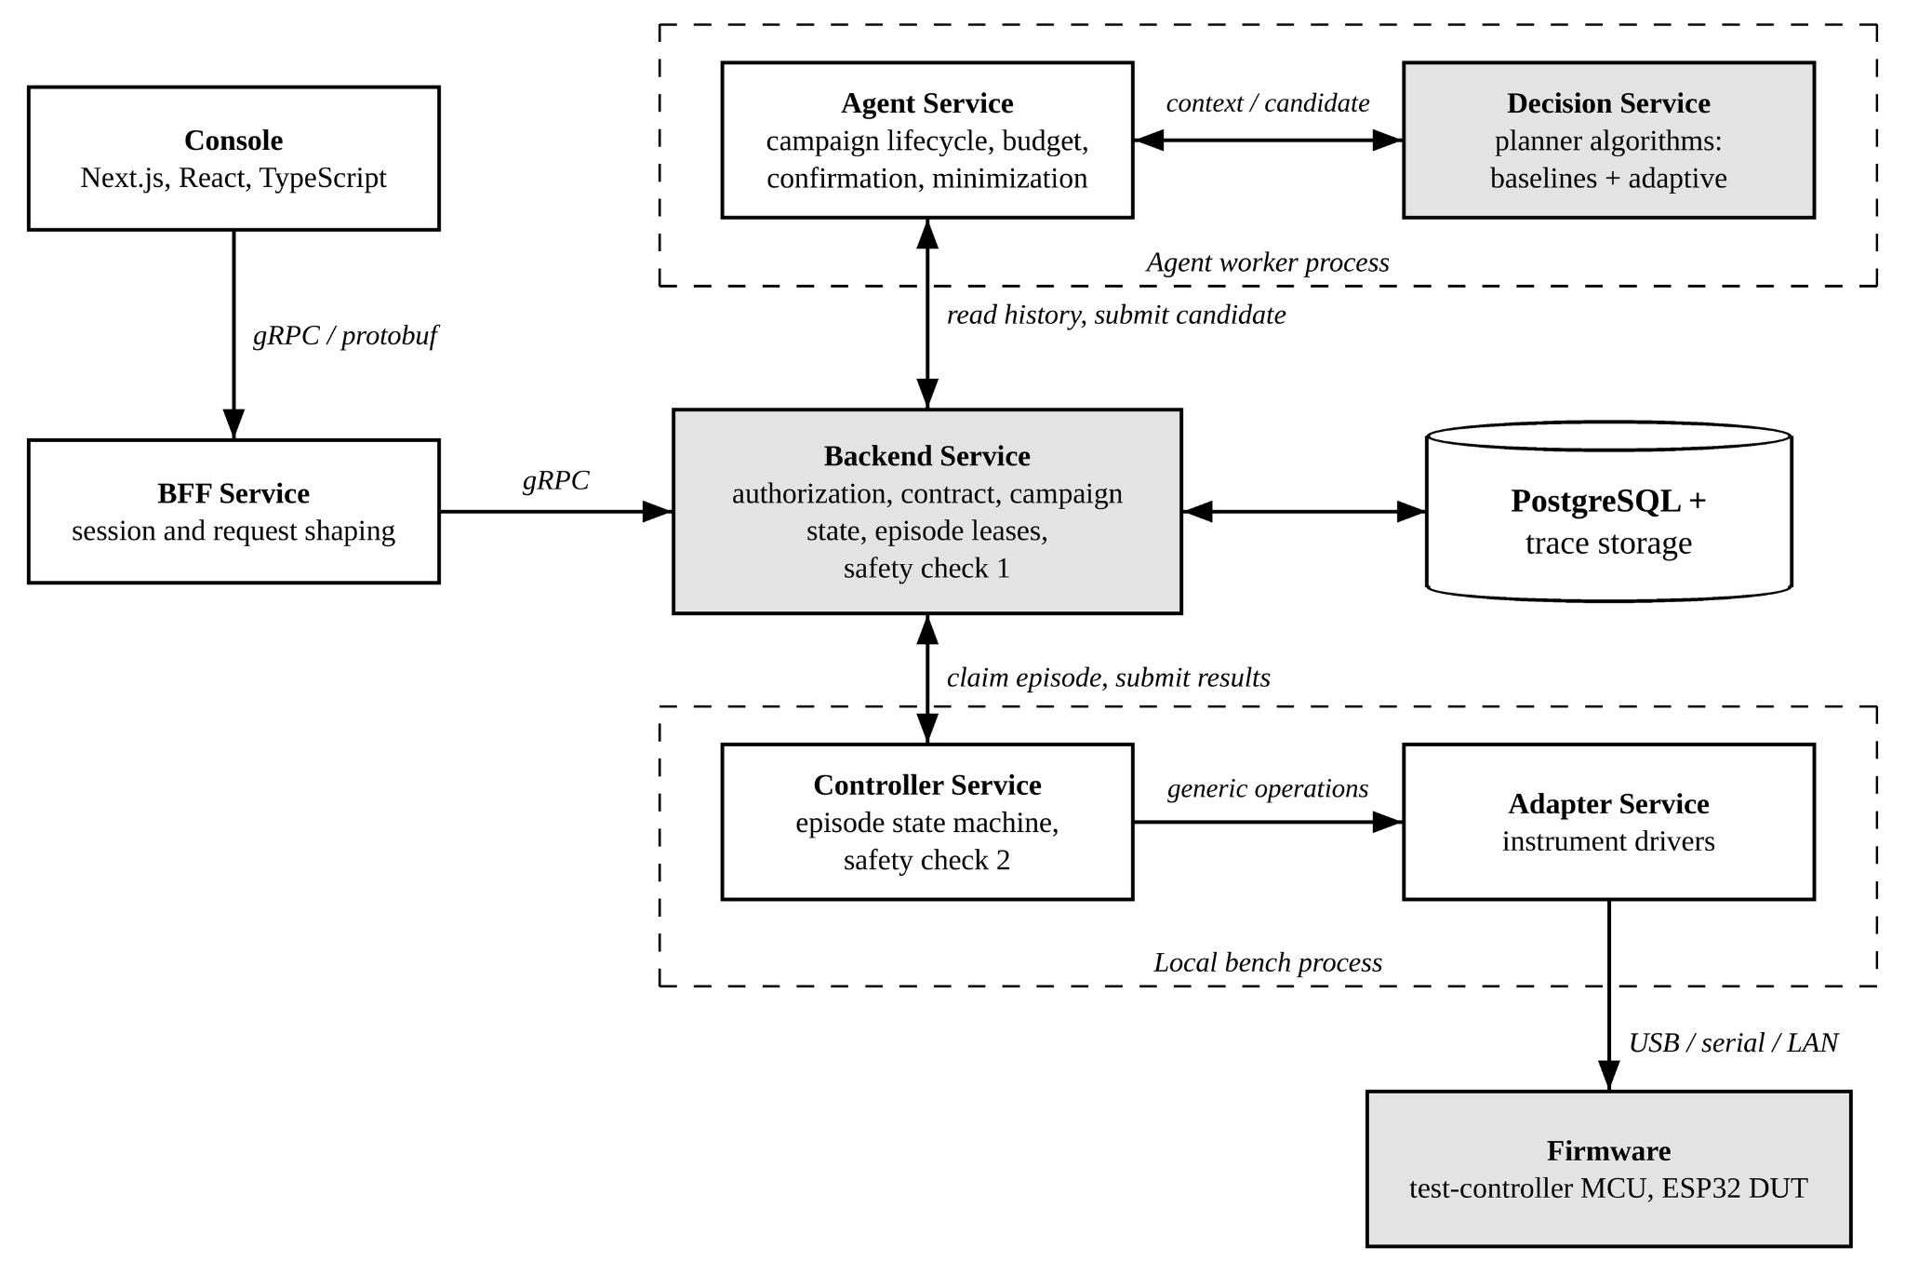
Methodology - Microservice Architecture

Slide 11
Methodology - Algorithm
Search Space Definition: Define voltage ranges, LED states, and firmware workloads in a test contract.
Initial Exploration: Use random trials to collect initial observations across different configurations.
Adaptive Search: Apply the TPE algorithm to prioritize configurations associated with lower robustness scores.
Safety Validation: Validate every proposed configuration against predefined operating limits using a deterministic safety kernel.
Hardware Execution: Execute approved experiments on the ESP32-S3 using the RP2040 controller.
Failure Detection: Evaluate telemetry against requirements and calculate robustness scores.
Failure Minimization: Replay failures and remove unnecessary conditions.
Performance Evaluation: Compare TPE against Random Search and Grid Search using simulation and physical experiments.

Slide 12
Working - Algorithm
Trial Classification: The algorithm separates previous experiments into good and bad groups based on their robustness scores, prioritizing configurations with lower scores.
Probability Modeling: It estimates probability distributions (l(x)) and (g(x)) for good and bad configurations, using Parzen estimators to model promising parameter values and combinations.
Adaptive Sampling: TPE selects new configurations that maximize the ratio \(l(x)/g(x)\), favouring promising candidates. Results from each experiment update the distributions, improving subsequent searches.

Slide 13
Proposed Outcomes
Expected Results
Develop an adaptive hardware-testing solution that identifies failure-prone configurations efficiently within a limited testing budget.
Compare its performance against Random, Grid, Space-Filling, and Pairwise Testing methods.
Validate failure detection, reproducibility, and safety on physical hardware using voltage, current, timing, heartbeat, reset, and OLED measurements.
Potential Impact on the Field
Reduce the time and number of experiments needed to discover hardware failures compared with conventional testing methods.
Provide a reproducible framework for evaluating adaptive testing techniques under realistic hardware conditions.
Support safer and more efficient hardware validation without treating the absence of detected failures as proof of complete safety.
Future Research Directions
Extend the framework to additional hardware platforms, DUT designs, and more complex workloads.
Investigate advanced adaptive-search algorithms and their ability to detect intermittent failures and parameter interactions.
Develop standardized hardware-fuzzing benchmarks and explore applications to industrial embedded systems and reliability testing.

Slide 14
Timeline of the project
Project Timeline Overview
Initiation Phase (Weeks 1-2)
  Define the research question: can adaptive test selection find failures in fewer physical experiments than conventional testing methods?
  Freeze the scope: one ESP32-S3 DUT, three programmable rails, extra-low-voltage only.
  Identify group members and roles; inventory laboratory instruments.
  Conduct feasibility studies and a literature review; complete the Phase-1 demonstration.
Planning Phase (Weeks 3-4)
  Develop the project plan and high-level designs: system, hardware, safety state machine, test contract.
  Define the test contract, safety limits and benchmarks B1–B3; pre-register metrics and episode budgets.
  Build the simulator, planner interface and baseline planners (Random, Grid, Space-Filling, Pairwise).
  Gate (Week 4): no safe, remotely controllable rail with read-back means pivot to simulation.

Slide 15
Timeline of the project
Project Timeline Overview
Execution Phase (Weeks 5-10)
  Build safe instrument control: test-controller MCU, watchdog, E-stop and rail calibration. Gate (Week 8): 100 nominal episodes with under 5% invalid.
  Develop the ESP32 firmware and hidden seeded OLED fault; measure voltage, current, timing, heartbeat, reset and OLED response.
  Integrate the adaptive planner, failure confirmation (repeat runs) and the minimizer.
  Hold regular team meetings, with a weekly live demonstration on the rig.
Closure Phase (Weeks 11-13)
  Run the safety acceptance suite. Gate (Week 12): zero unsafe executions, or no adaptive hardware campaigns.
  Run repeated, seeded campaigns comparing the adaptive method against Random, Grid, Space-Filling and Pairwise testing, and analyze the results.
  Freeze code and hardware, archive raw data with checksums, and obtain panel approval.
  Document lessons learned and prepare the research paper draft.

Slide 16
Conclusion
Conclusion
The Adaptive Hardware Fuzzing Testbench (AHFT) aims to improve embedded-system testing by intelligently selecting experiments based on previous results. By discovering, reproducing, and minimizing hardware failures while adhering to predefined safety constraints, the framework seeks to make testing more efficient and systematic.
The project promotes experiential learning through hands-on experimentation, hardware interaction, and iterative analysis. It aligns with UN SDG 9: Industry, Innovation and Infrastructure, particularly Target 9.5, by exploring innovative approaches to hardware testing and technological research.

Slide 17
References
Yun, J., Rustamov, F., Kim, J., & Shin, Y. (2023). Fuzzing of embedded systems: A survey. ACM Computing Surveys, 55(7). https://doi.org/10.1145/3538644
Eisele, M., Maugeri, M., Shriwas, R., Huth, C., & Bella, G. (2022). Embedded fuzzing: A review of challenges, tools, and solutions. Cybersecurity, 5, Article 18. https://doi.org/10.1186/s42400-022-00123-y
Sui, Y., Gotovos, A., Burdick, J., & Krause, A. (2015). Safe exploration for optimization with Gaussian processes. In Proceedings of the 32nd International Conference on Machine Learning (Vol. 37, pp. 997–1005). Proceedings of Machine Learning Research. https://proceedings.mlr.press/v37/sui15.html
Berkenkamp, F., Krause, A., & Schoellig, A. P. (2023). Bayesian optimization with safety constraints: Safe and automatic parameter tuning in robotics. Machine Learning, 112, 3713–3747. https://doi.org/10.1007/s10994-021-06019-1

Slide 18
Our Team
USN | Name
1RV24CS126 | Kavin Krishnan C
1RV24CS068 | Chinmai Kiran Shetti
1RV24IS130 | Sumukha Upadhyaya
1RV24IS126 | Snehal Reddy Thadigotla
1RV24CY055 | Sutej R Haritsa
Team No
29
Team name
Chip Tech
Guide
Dr. H K Krishnappa
Phase
EL Phase I
SDG 9: Industry, Innovation and Infrastructure

Slide 19
Thank you

